Slide 1
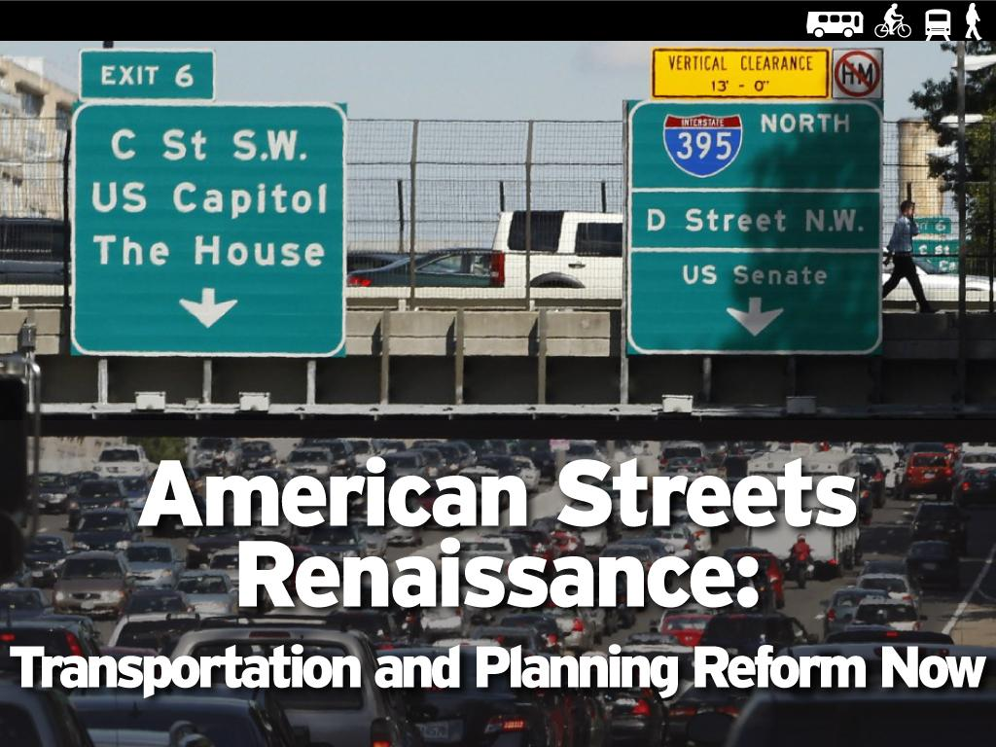
Notes:
Hi. I am Mark Gorton. I have been actively involved in the transportation reform movement in New York City for over a decade. We have had great success in NYC, and now I am working to improve the US's transportation policies nationally.

Slide 2
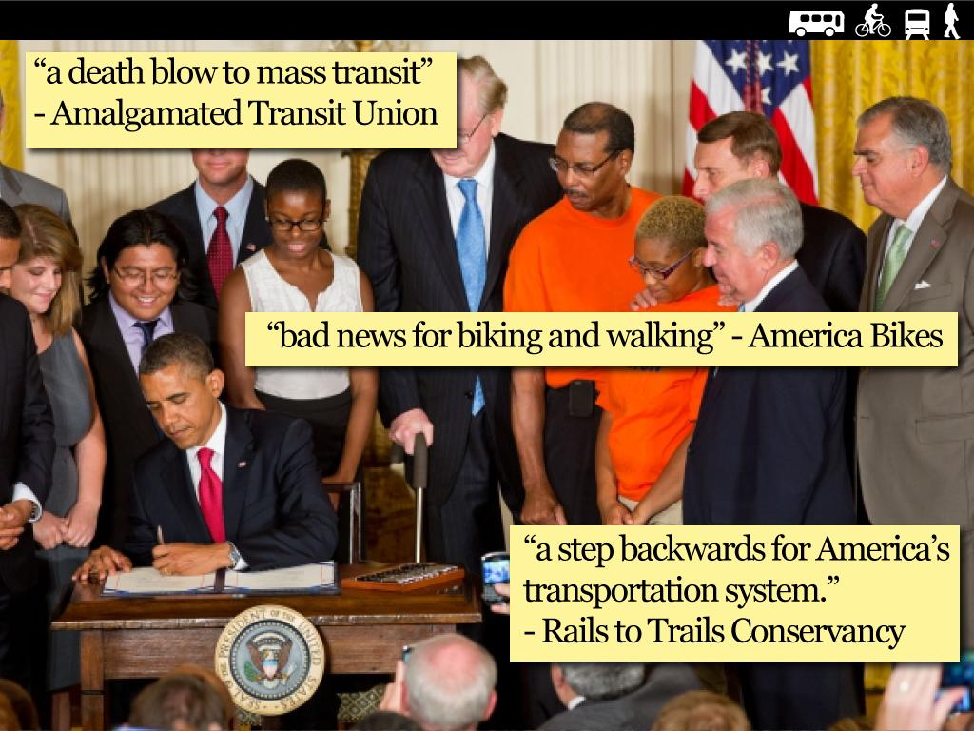
MAP-21: We got our butts kicked.
Notes:
Despite the growing popularity of progressive transportation, we got killed.
We got our butts kicked in the most recent transportation reauthorization.
MAP-21 got jammed down our throats by a combination of House Republicans and ASHTO (state DOT's).
Our messages did not seem relevant to many people in the country.

Slide 3
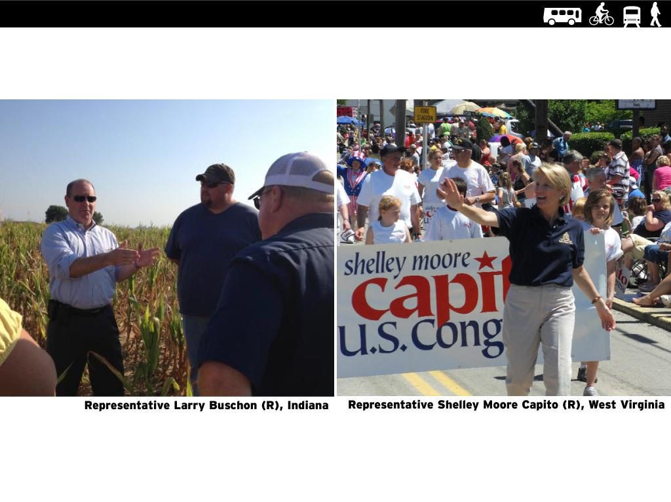
Framing issues for rural Republicans.
Notes:
House Republicans are almost exclusively suburban or rural. Pleas for transit, social justice, impoverished minorities, transit oriented development, or protected bike networks, etc. are pretty much worthless.
Here are some of my thoughts on how we need to frame our issues if we are going to be able to communicate to suburban and rural republicans.
We cannot win until rural republicans see that our ideas work for them.

Slide 4
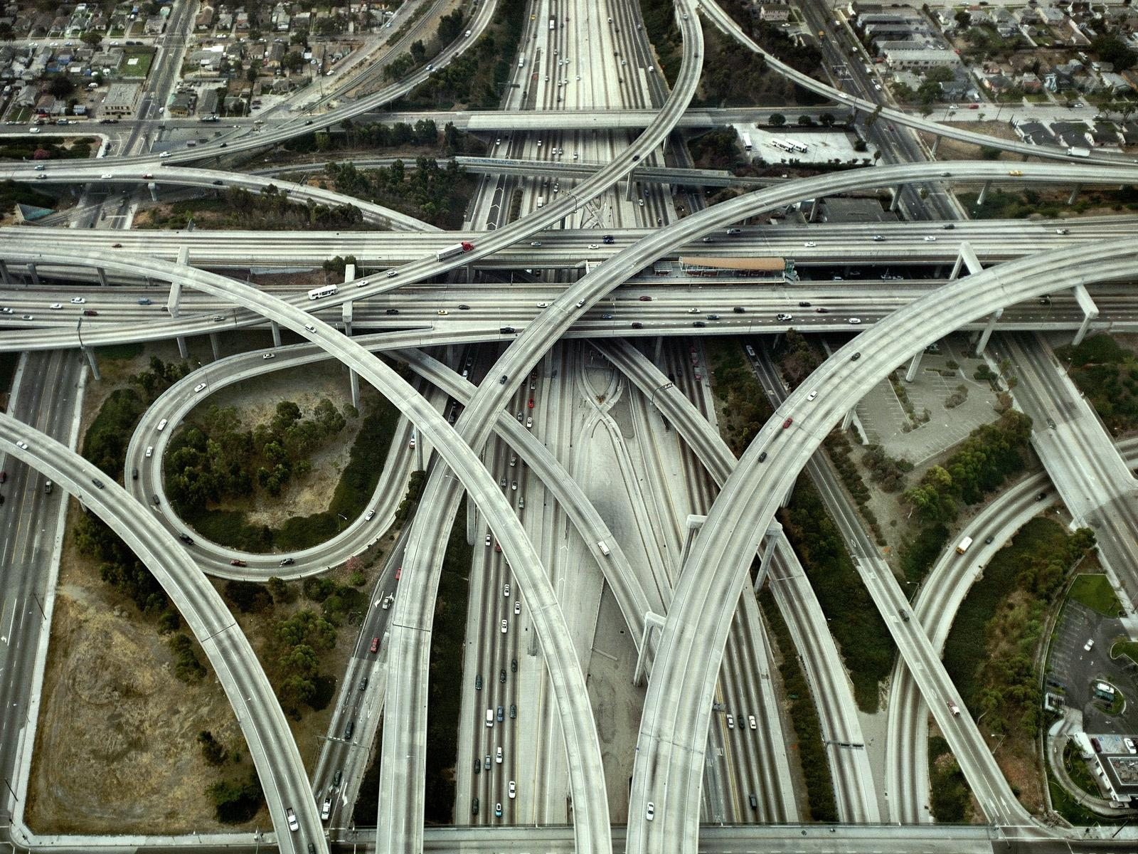
The 20th century was the century of the automobile.
Notes:
20th century, was the century of the car, we built a huge amount of automobile infrastructure, and we worked very hard to make it as easy as possible to drive, but we were short sighted and missed all sort of things. The US has done an amazing job building out its road network, and we have built more than enough roads for this country.

Slide 5
During the 20th Century, the impact of traffic on the human environment was an afterthought.

Slide 6
With auto oriented planning, we have significantly degraded the human living environment.

Slide 7
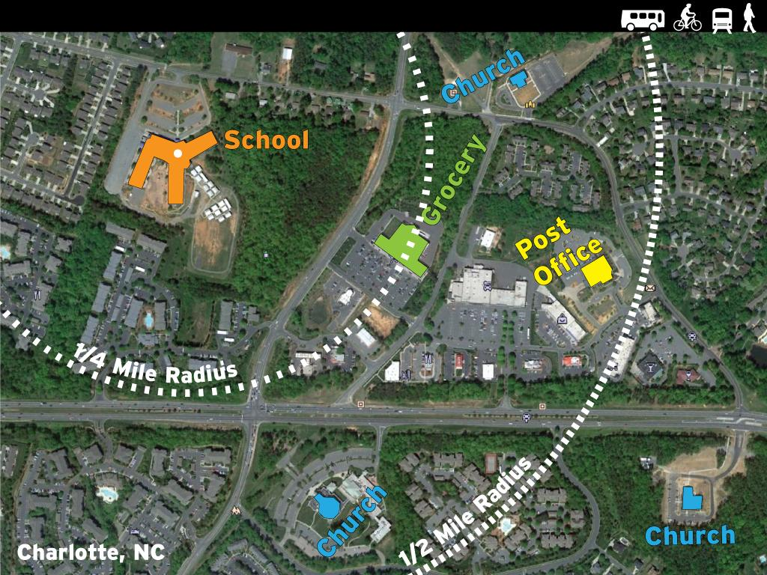
The Right to Walk
Notes:
By focusing solely on auto movement, we have made it so hard to walk that it verges on a human rights violation. This shows how we have sliced our word, and it is unsafe/impracticle/impossible to walk distances. Walking in not a democratic or republican thing. It is a human thing.
This is an area of Charlotte, NC known as Prosperity Church Road and is a good example of a typical late 20th century american land-use pattern.
The maximum distance between any two points in this aerial view is 1 mile and yet the likelihood that residents of these neighborhoods would walk to any of the institutions I've highlighted here is close to zero. (suggestion and background from PW 9/5)
Coordinates: 35.332720, -80.799091

Slide 8
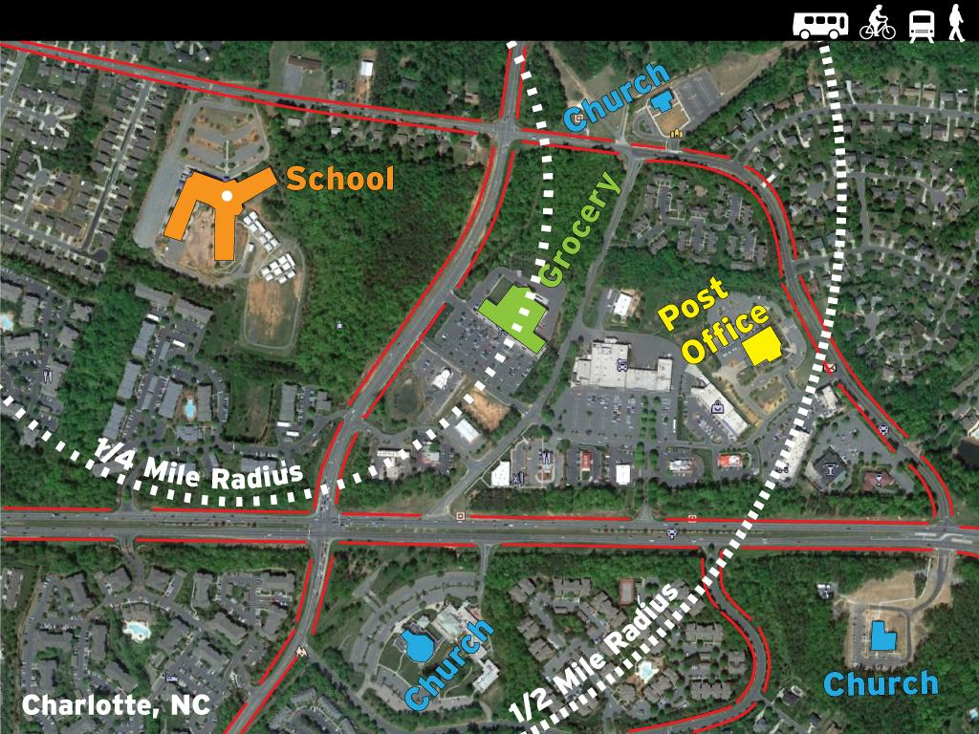
The Right to Walk
Notes:
By focusing solely on auto movement, we have made it so hard to walk that it verges on a human rights violation. This shows how we have sliced our word, and it is unsafe/impracticle/impossible to walk distances. Walking in not a democratic or republican thing. It is a human thing.
This is an area of Charlotte, NC known as Prosperity Church Road and is a good example of a typical late 20th century american land-use pattern.
The maximum distance between any two points in this aerial view is 1 mile and yet the likelihood that residents of these neighborhoods would walk to any of the institutions I've highlighted here is close to zero. (suggestion and background from PW 9/5)
Coordinates: 35.332720, -80.799091

Slide 9
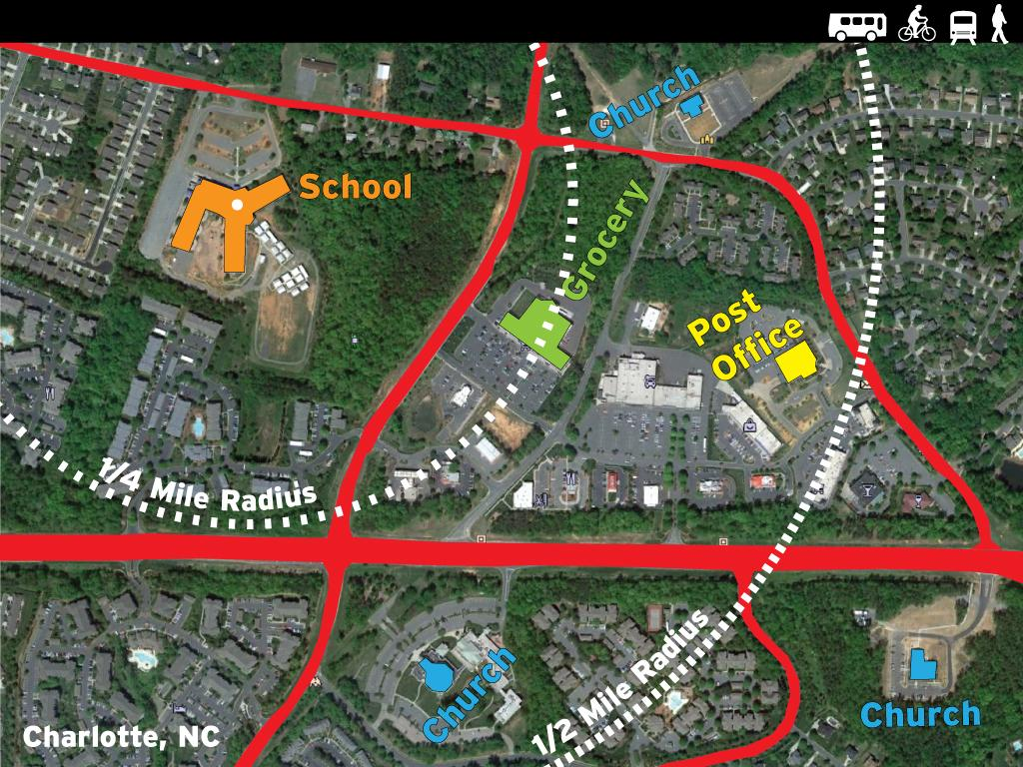
The Right to Walk
Notes:
By focusing solely on auto movement, we have made it so hard to walk that it verges on a human rights violation. This shows how we have sliced our word, and it is unsafe/impracticle/impossible to walk distances. Walking in not a democratic or republican thing. It is a human thing.
This is an area of Charlotte, NC known as Prosperity Church Road and is a good example of a typical late 20th century american land-use pattern.
The maximum distance between any two points in this aerial view is 1 mile and yet the likelihood that residents of these neighborhoods would walk to any of the institutions I've highlighted here is close to zero. (suggestion and background from PW 9/5)
Coordinates: 35.332720, -80.799091

Slide 10
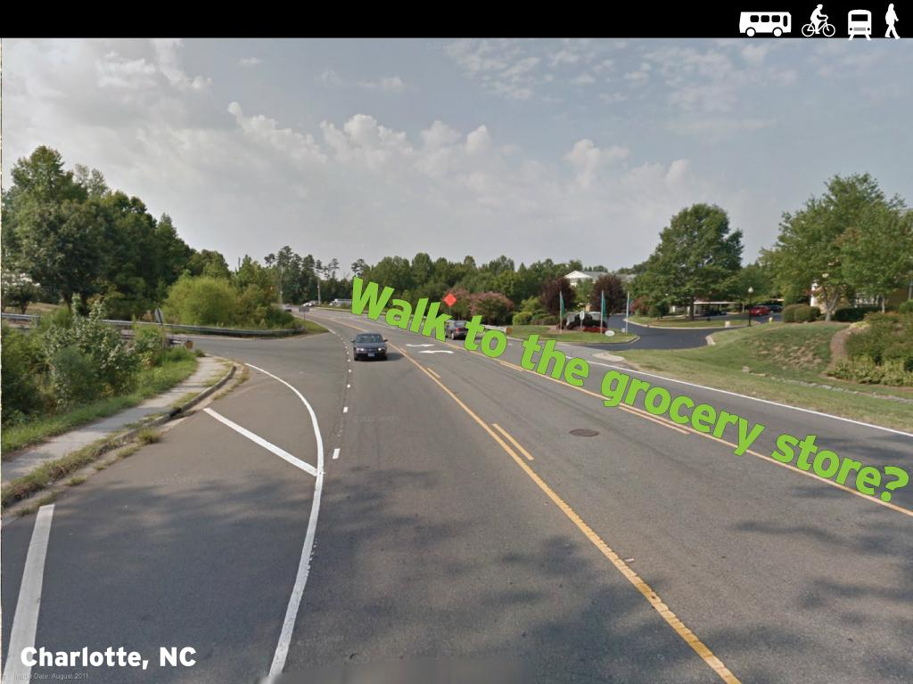
The Right to Walk
Notes:
This is the street outside the local grocery store.

Slide 11
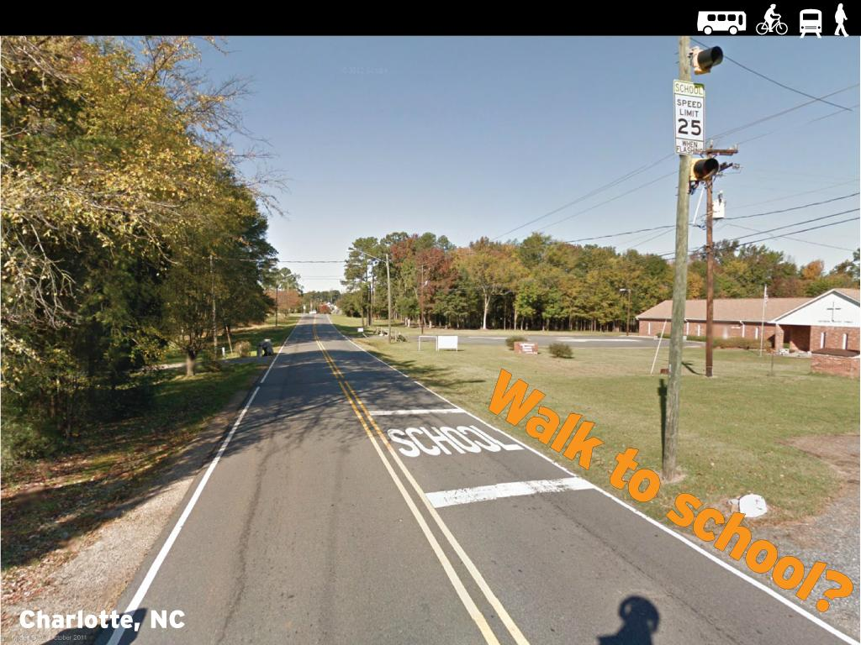
The Right to Walk
Notes:
This is the street outside the local elementary school.

Slide 12
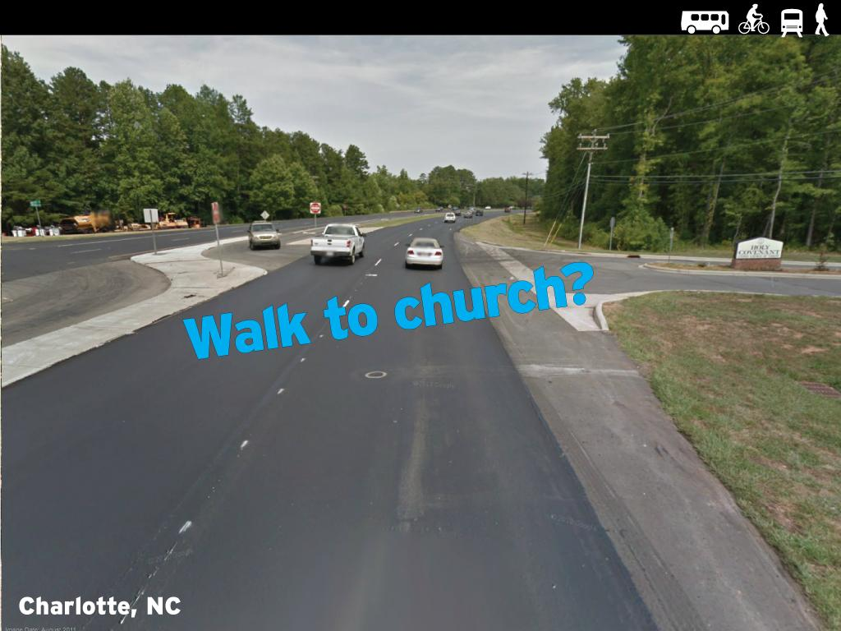
The Right to Walk
Notes:
The designs that come out of the AASHTO manual are human rights violations.

Slide 13
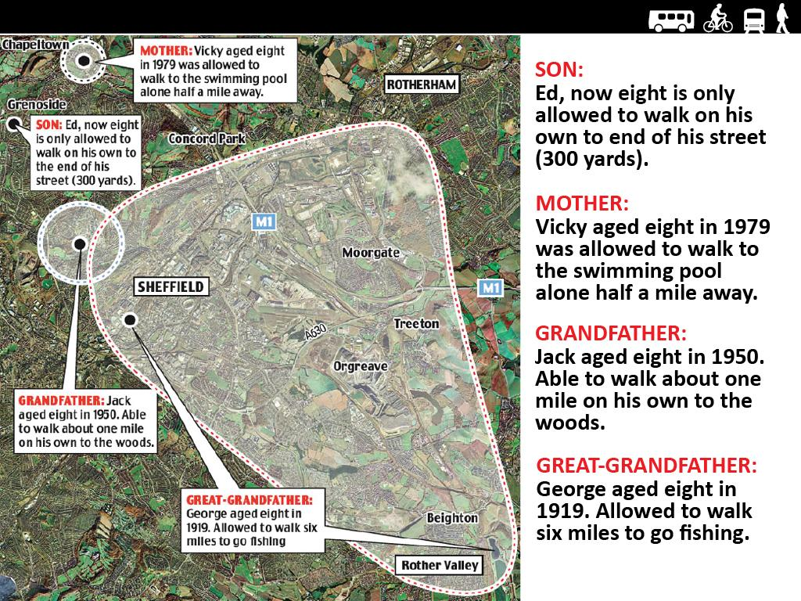
The crisis of childhood mobility: The right to roam
Notes:
Everybody, Democrat and Repbulican, Urban, Suburan and Rural wants our kids to have a good life.
https://philebersole.wordpress.com/tag/free-range-children/

Slide 14
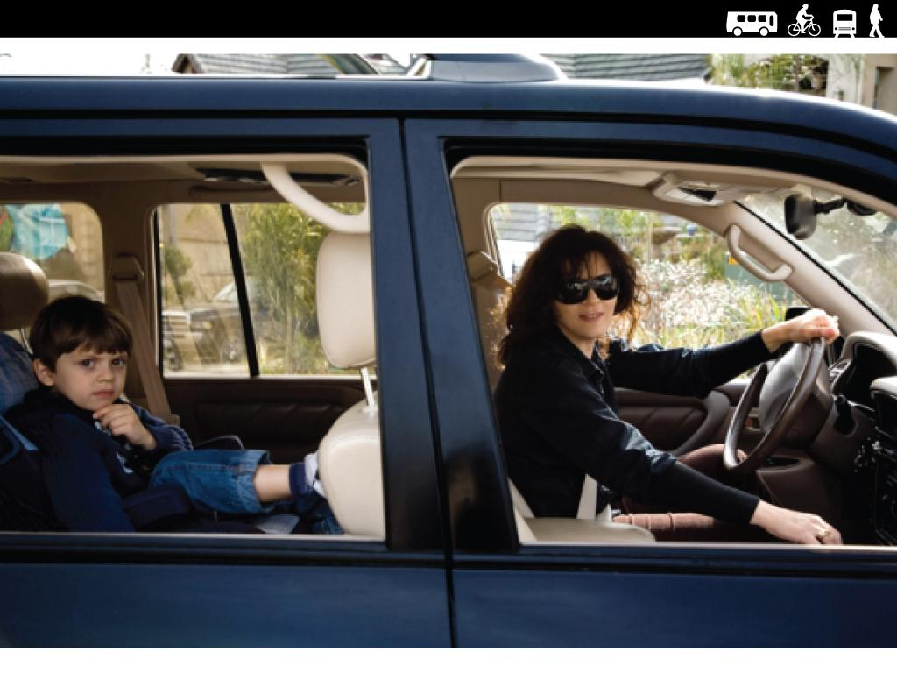
The crisis of childhood mobility: Burden on parents

Slide 15
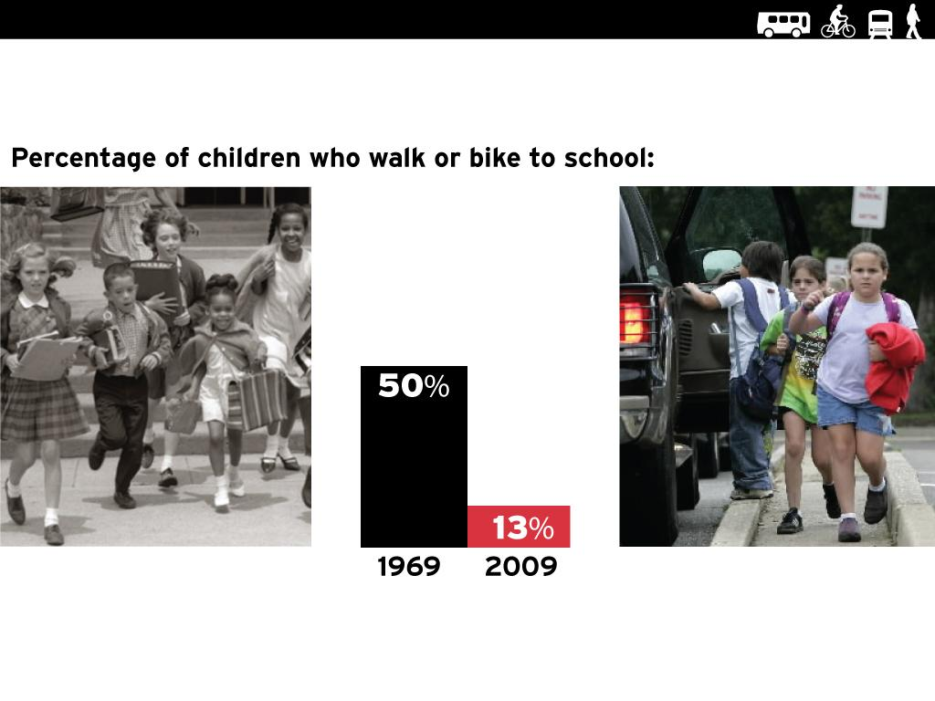
The drastic decline in walking and biking to school
Notes:
This is a crisis. This is a big deal.

Slide 16
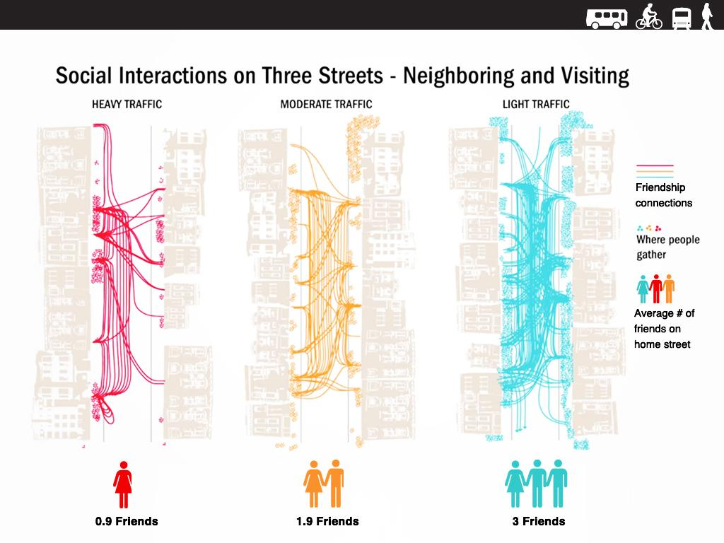
Traffic harms human relationships.

Slide 17
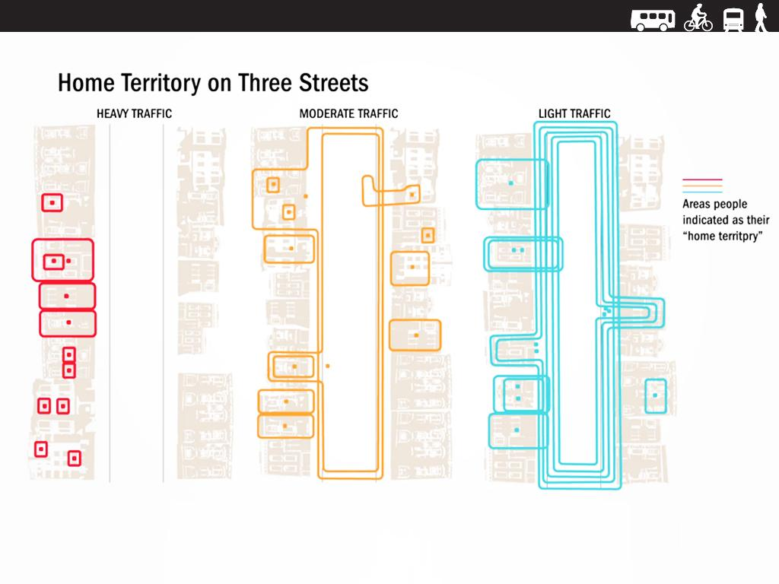
Traffic shrinks our home territory.

Slide 18
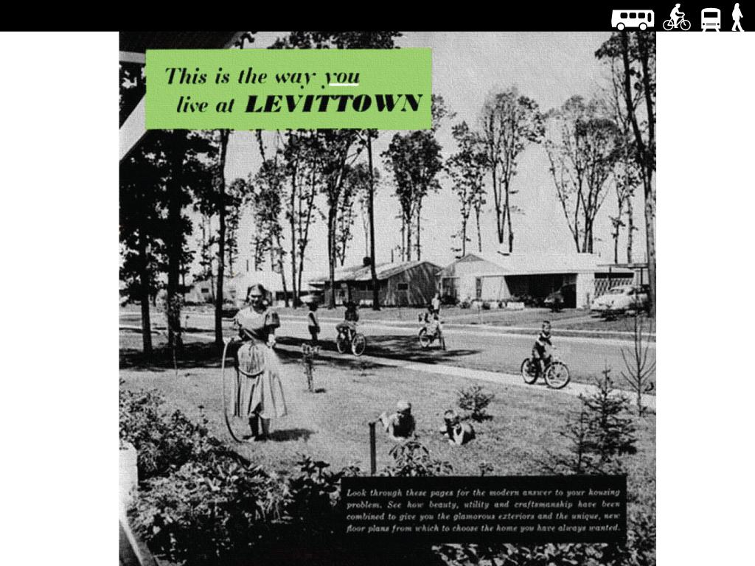
Suburbs were sold as "communities"
Notes:
Suburban living was sold to Americans as providing a place where communities would flourish. Many suburban developments have tended to separate people.

Slide 19
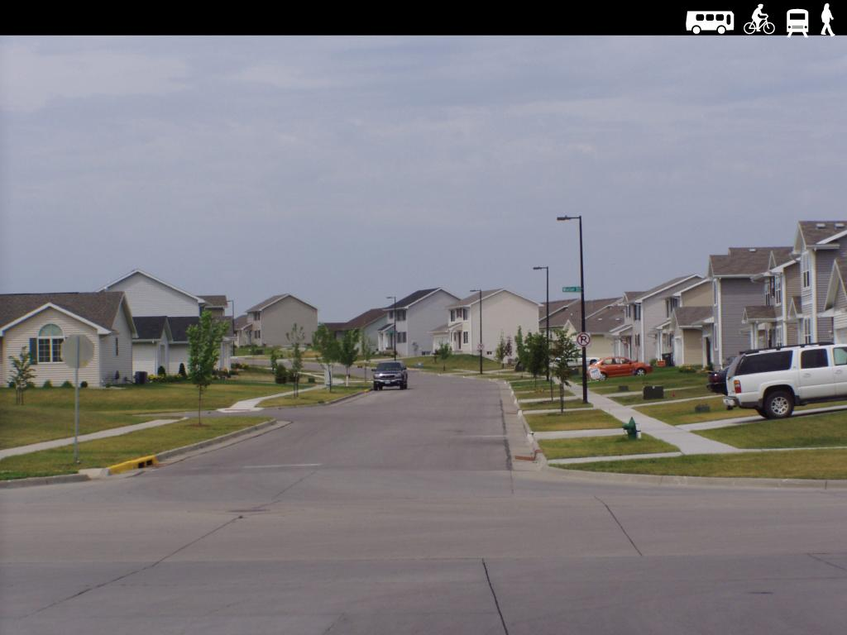
But, suburbs can be very lonely places.
Notes:
Auto dependence has undermined the social fabric of our communities. Our suburban neighborhoods look nice from an abstract point of view, but we have forgotten about the element of community.

Slide 20
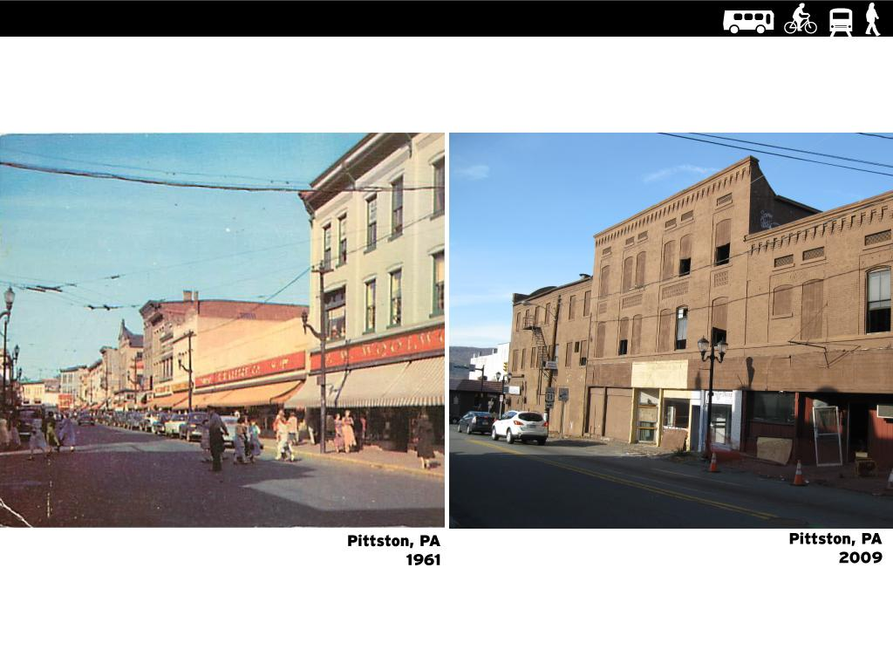
Suburbanization caused thriving small downtowns to fail.

Slide 21
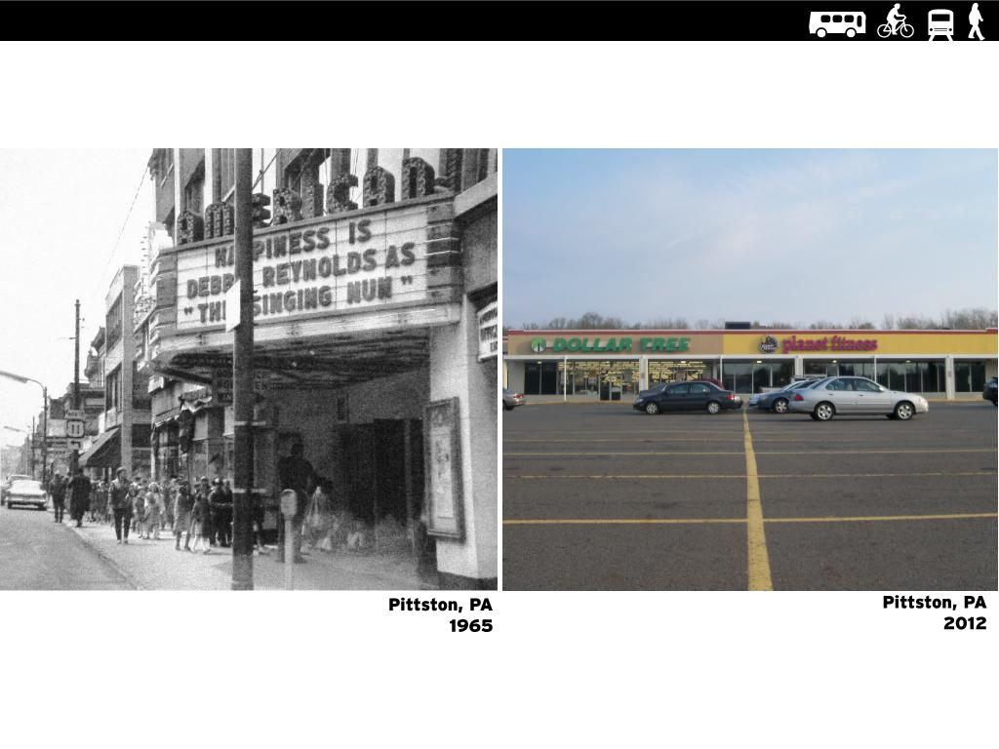
We traded walkable communities for parking lots.

Slide 22
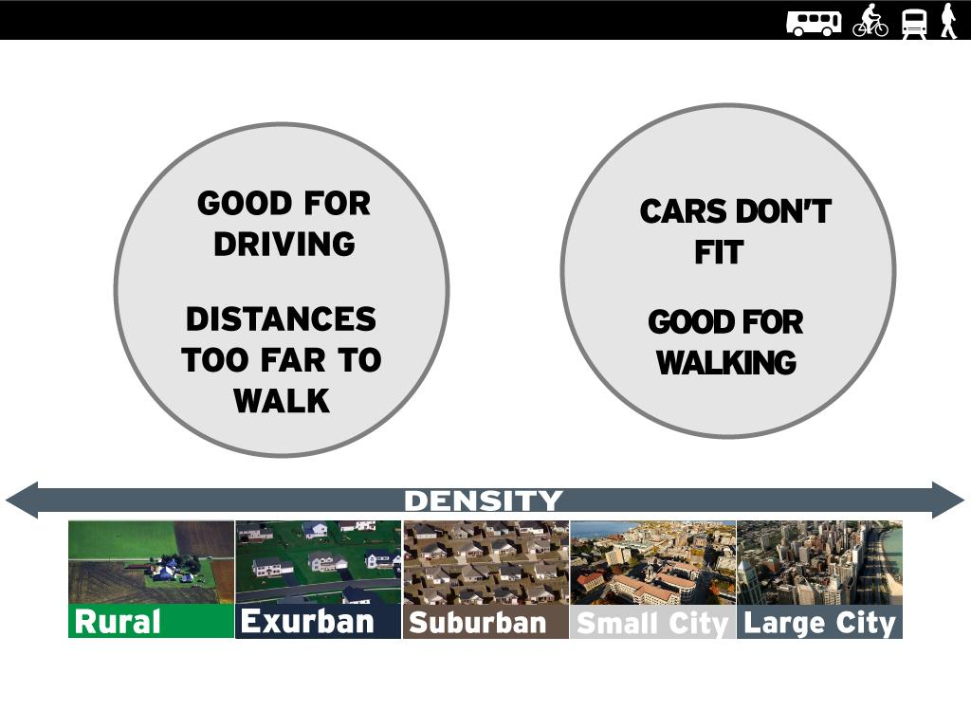
The fundamental incompatibility of people and cars.

Slide 23
Fiscal Soundness.

Slide 24
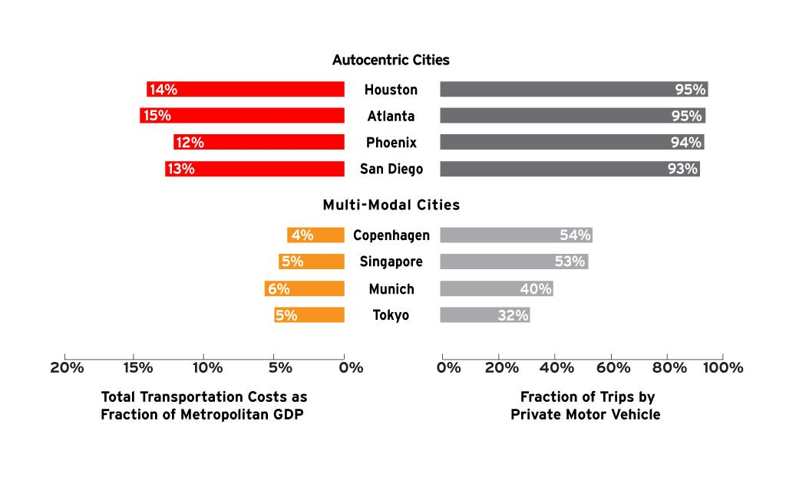
technology for a society.
The automobile is the most expensive transportation

Slide 25
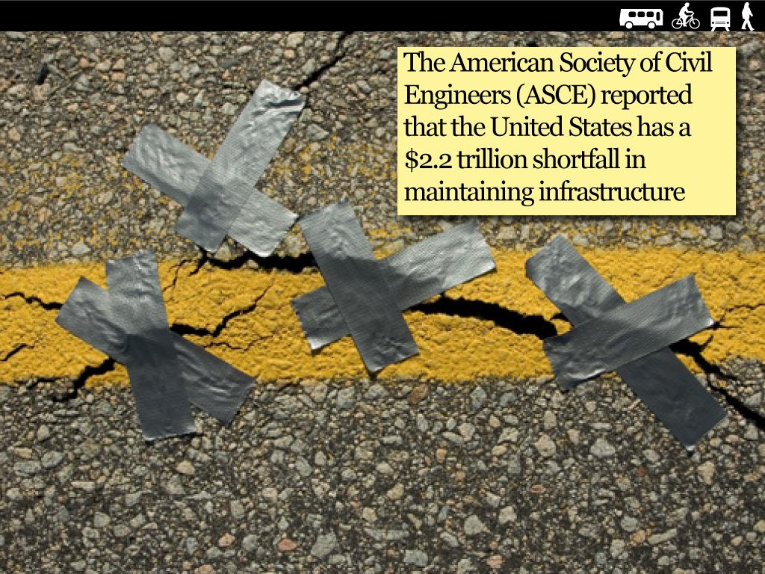
Our road infrastructure is unsustainable.

Slide 26
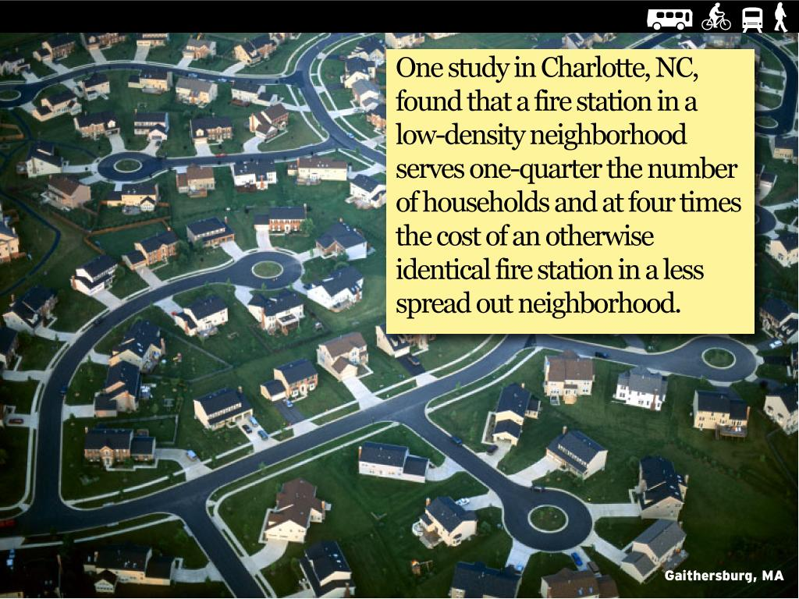
The costs of sprawl.
Notes:
Distant development costs more, gradually bleeding taxpayers and putting the hurt on municipal budgets.
The cost is enormous. One study in Charlotte, North Carolina, found that a fire station in a low-density neighborhood serves one-quarter the number of households and at four times the cost of an otherwise identical fire station in a less spread out neighborhood. That sort of inefficiency adds up and multiplies as you take into account the hundreds of services cities must provide.
http://globalpublicsquare.blogs.cnn.com/2012/07/31/the-cost-of-americas-inefficient-sprawl/

Slide 27
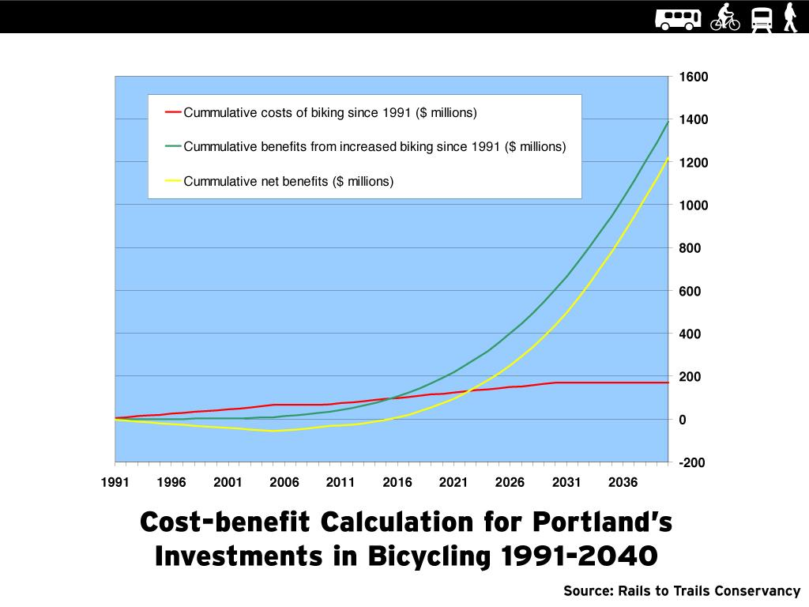
Walking and biking are very cost effective.
Notes:
By 2040 Portland’s net benefits from bicycling in the form of fuel savings and reduced health care costs alone will amount to $1.2 billion, or a return on investment ratio of 8.3 to 1.
Source: http://www.railstotrails.org/resources/documents/ourWork/Portland_one_pager.pdf

Slide 28
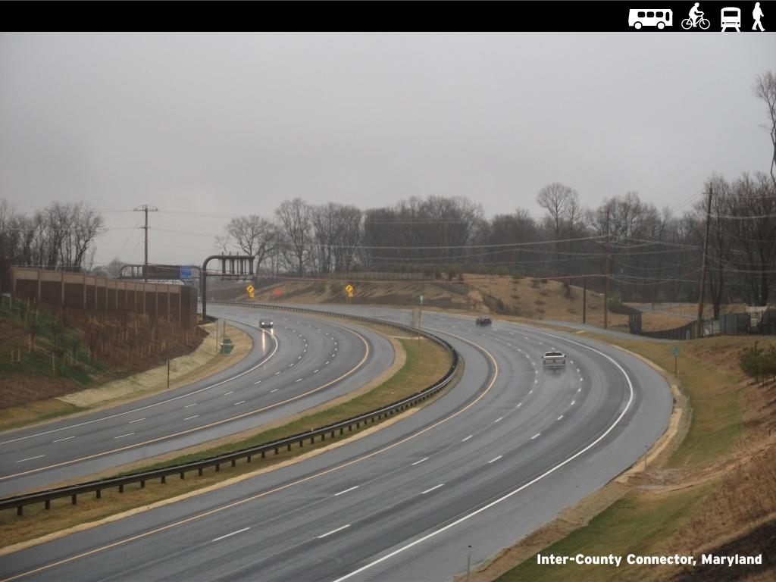
AASHTO prides itself on wasteful projects.
Notes:
At $2.4 Billion dollars, Maryland's Intercounty connector is an overbuilt waste of taxpayer money, but AASHTO has nominated it for an "America's Transportation Award". The backward thinking is bankrupting our country. When it comes to walking state DOT's can't cut enough. When it comes to driving, they can't over build enough.

Slide 29
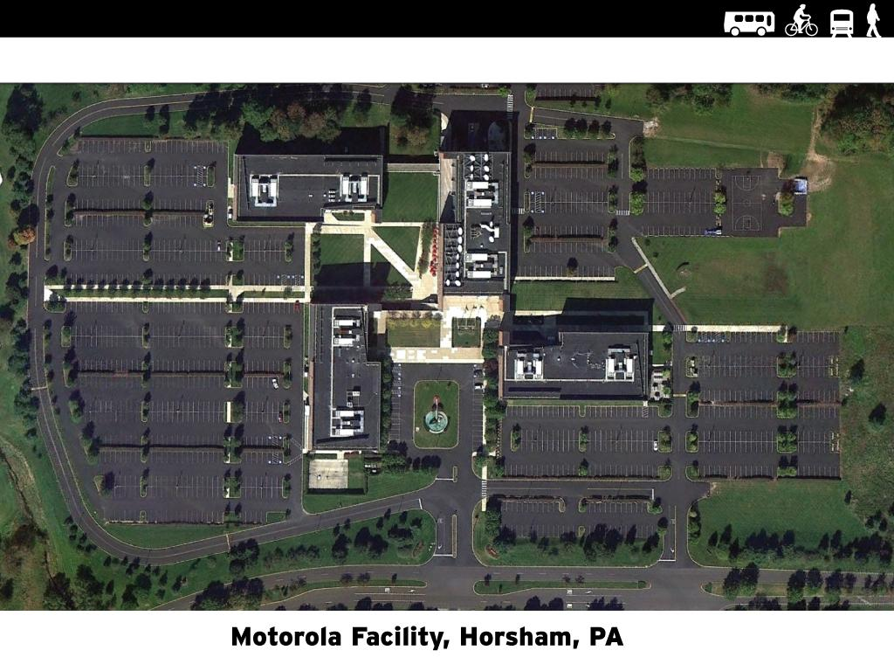
Auto dependence reduces economic competitiveness.
Notes:
Since auto is most expensive way to build transportation system, factory owners must pay extra burden for all the cars their employees own and all the road infrastructure necessary to support driving. Get picture of Lockheed Martin factory in Glen Burnie, MD where I used to work.

Slide 30
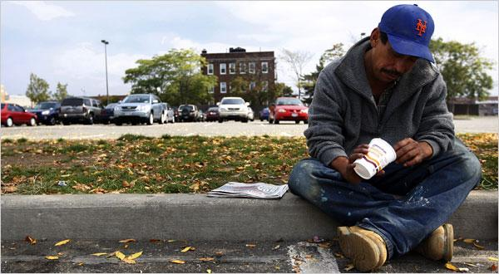
Auto dependence locks the poor into inescapable poverty.
Notes:
In an auto dependent world, those who can't afford a car are unable to work.

Slide 31
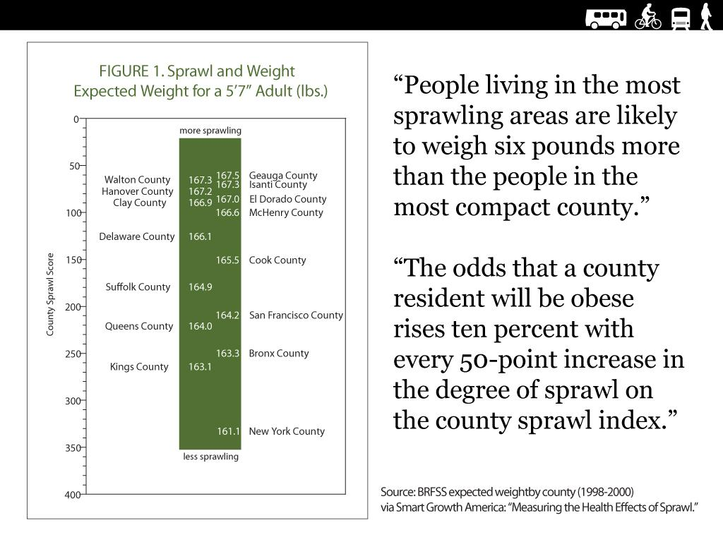
Auto dependence harms our health.

Slide 32
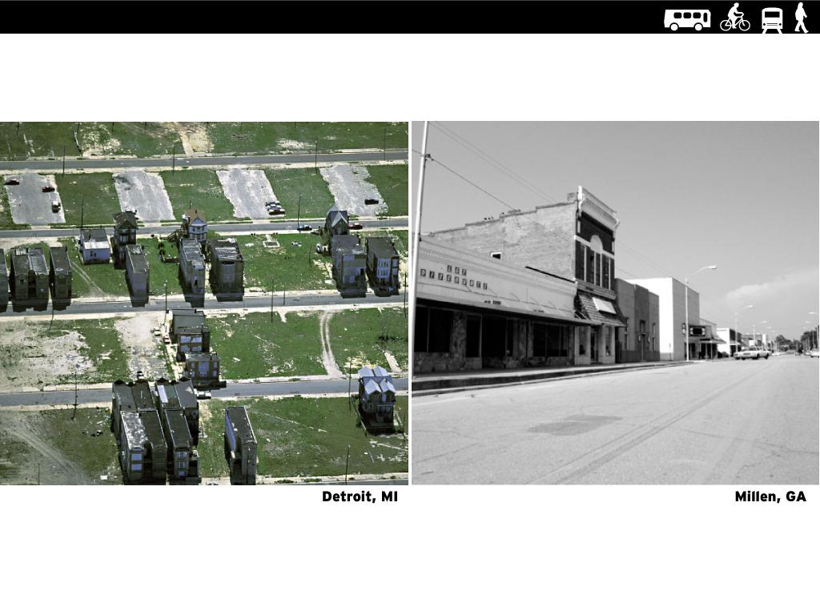
We have subsidized the destruction of our cities and towns.
Notes:
Background on Millen, GA http://www.theatlantic.com/national/archive/2009/06/death-of-a-small-town/20272/

Slide 33
Progressive transportation policies are working and are popular.
Notes:
People get it, when will the government?
Progressive transportation policies are working and are popular.

Slide 34
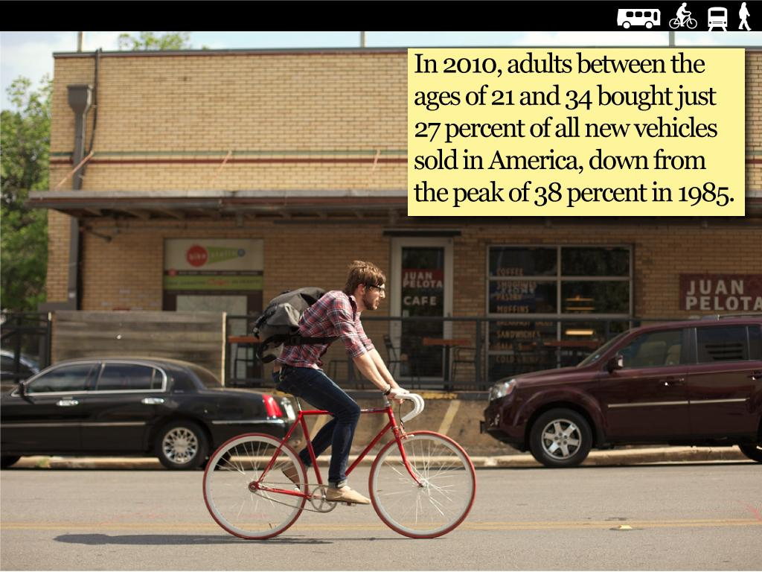
Car purchases are down.
Notes:
Kids have learned that getting into debt sucks, and cars and a car oriented lifestyle is really expensive. They also have learned from hard experience that being stuck in a car and in traffic is a pretty sucky life.

Slide 35
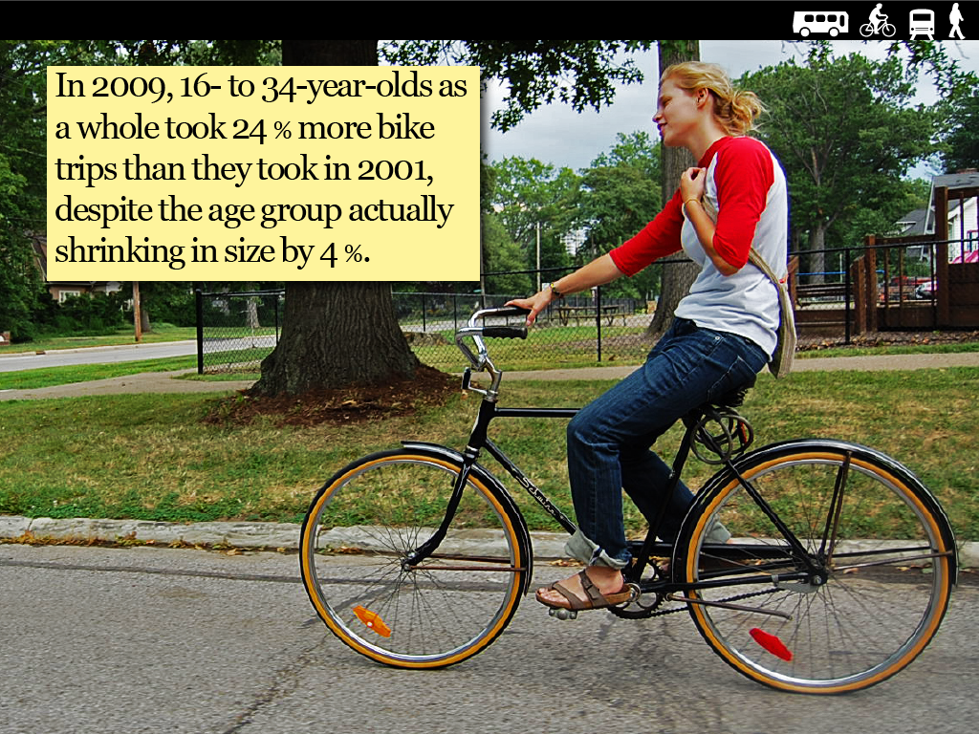
Biking is Up.

Slide 36
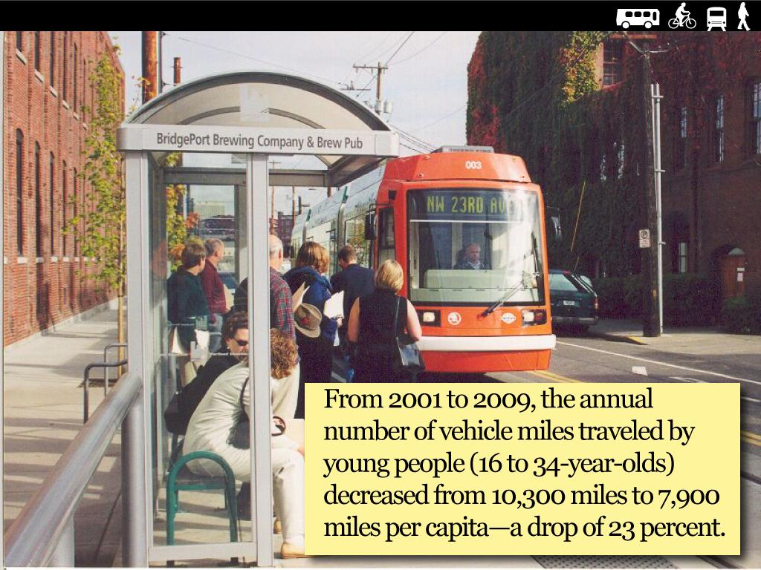
Driving is down.

Slide 37
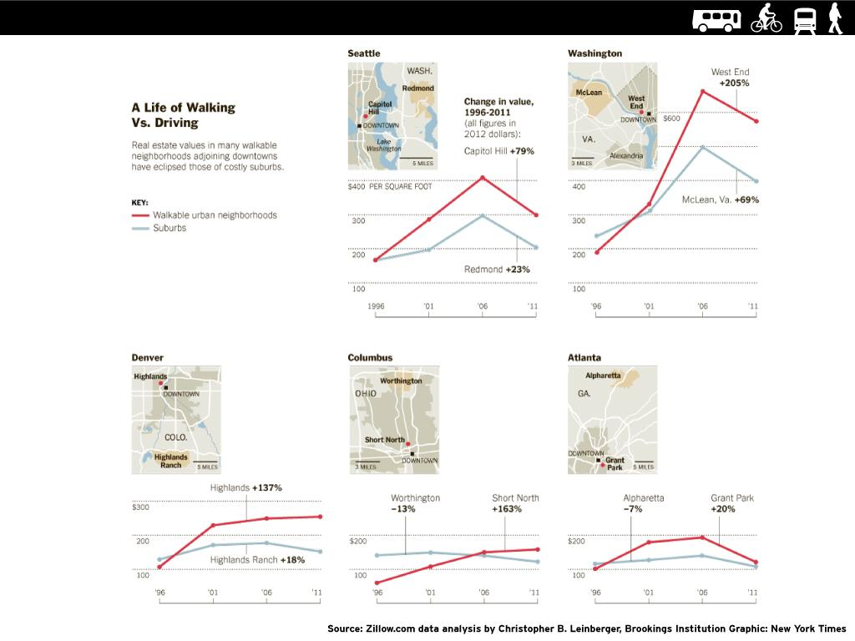
Walkability increases real estate values.

Slide 38
Auto-oriented policies have hurt our country in many ways:
1. Cars have invaded our living habitat and are degrading our world.
2. We have crippled walking in America.
3. We have crippled playing in America.
4. We are wasting enormous amounts of money
5. We are hurting American competitiveness.
6. We are trapping a large number of people in poverty.

Slide 39
What do we do?

Slide 40
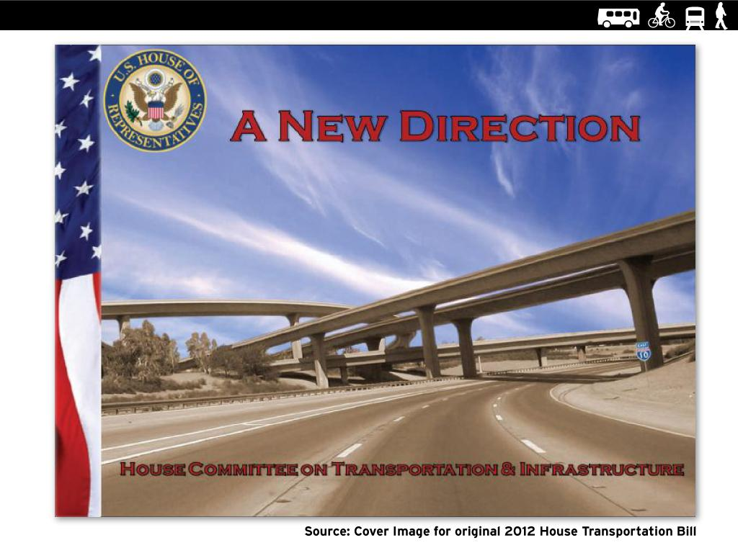
Change America's transportation policies.
Notes:
No more working around the edges. We have spent enough time showing what is wrong with the current system. The currently system is fundamentally flawed. We need to fix it now. In order to do this, we must do a better job communicating and organizing.

Slide 41
Goals:
1. Federal Transportation
Reauthorization Reform
2. State Transportation
and Planning Reform
3. Local Renaissances
Notes:
For state DOT reform, say that current methodologies of just building roads at State DOT's are completely flawed. Not just a little flawed, completely flawed, and need to be profoundly changed.

Slide 42
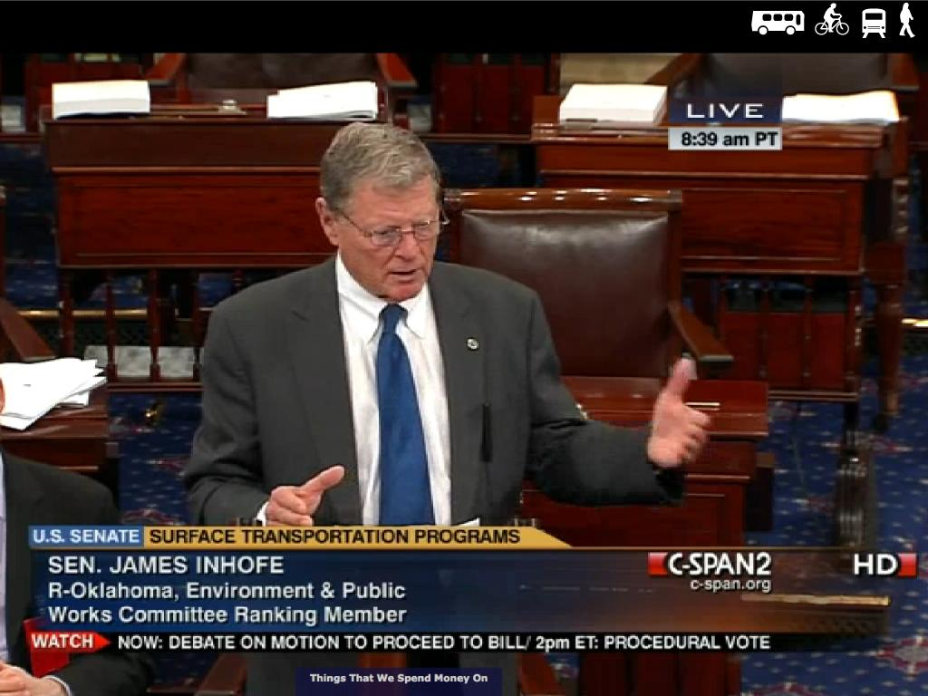
An inside the beltway strategy has proven to be a failure.
Notes:
We allowed safe routes to school to be gutted without one school child in the country protesting: This means that we are politically irrelevant.

Slide 43
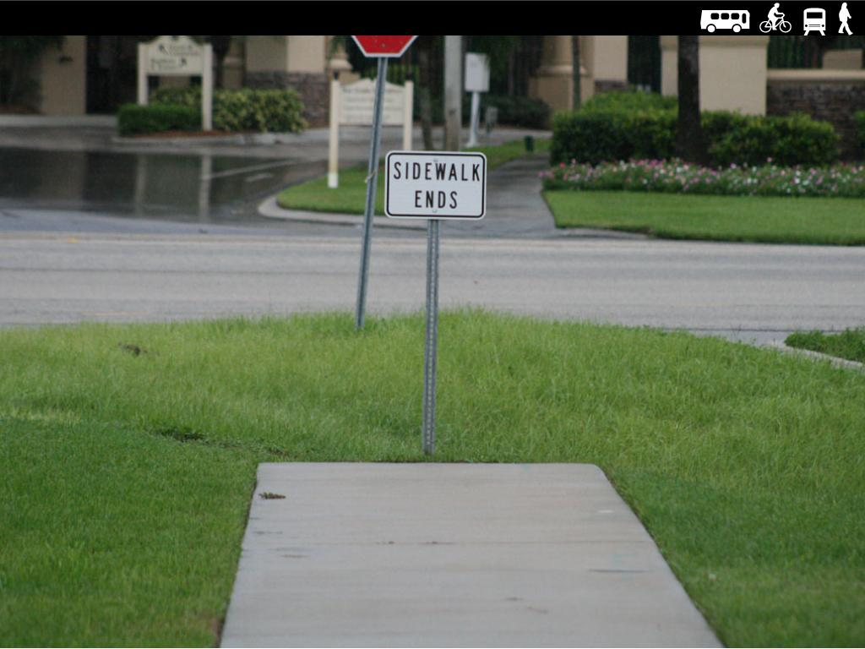
Stop being marginalized.
Notes:
Stop asking for crumbs (and then only getting a quarter of a crumb.) As a movement, we need to break out of the mental framework imposed on us by the auto industry. We have accepted their framing of our work for too long.

Slide 44
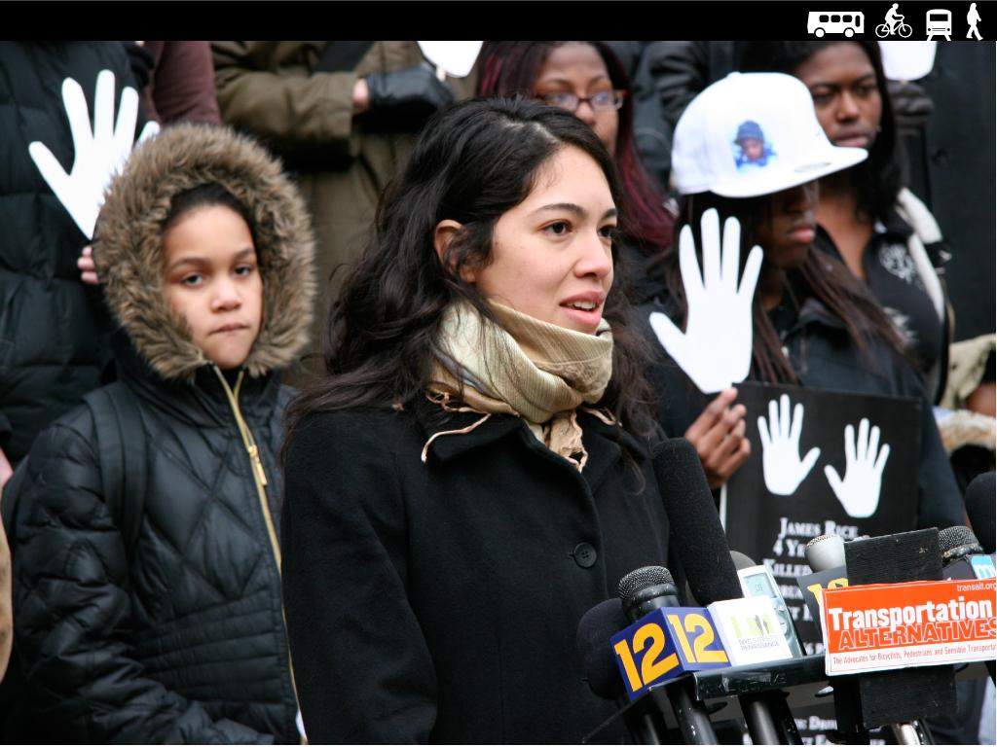
Speak the truth.
Notes:
Speak the Truth. Current methodologies of just building roads at State DOT's are completely flawed. Not just a little flawed, completely flawed, and need to be profoundly changed. The US's transportation policies are completely flawed.

Slide 45
So how do
we build a
political movement
with punch?

Slide 46
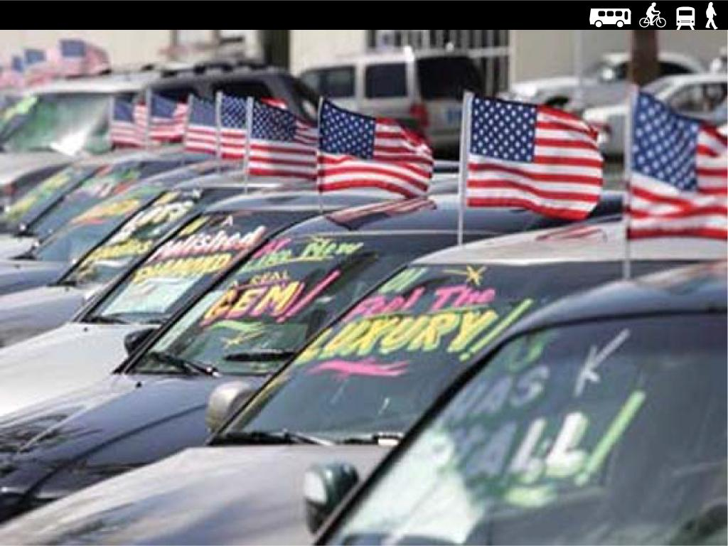
Build a nation campaign to change the way Americans think about transportation.
Notes:
This is a necessary first step. We will never win other changes without getting politicians, policy makers and the people to understand that we have profoundly flawed transportation policies.

Slide 47
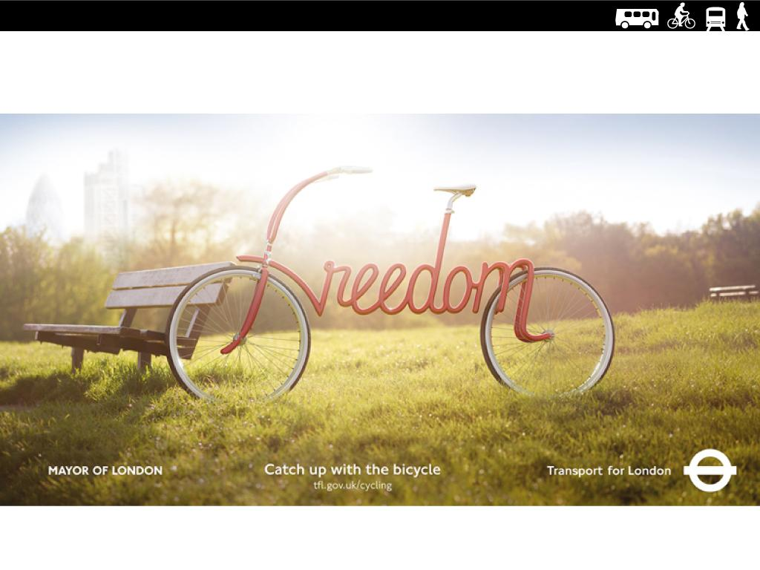
Get our messaging right.
Notes:
We need to take the time and effort to get our messages nice and tight and relevant, and packaged in a great way. Good graphics, videos, animations, etc.

Slide 48
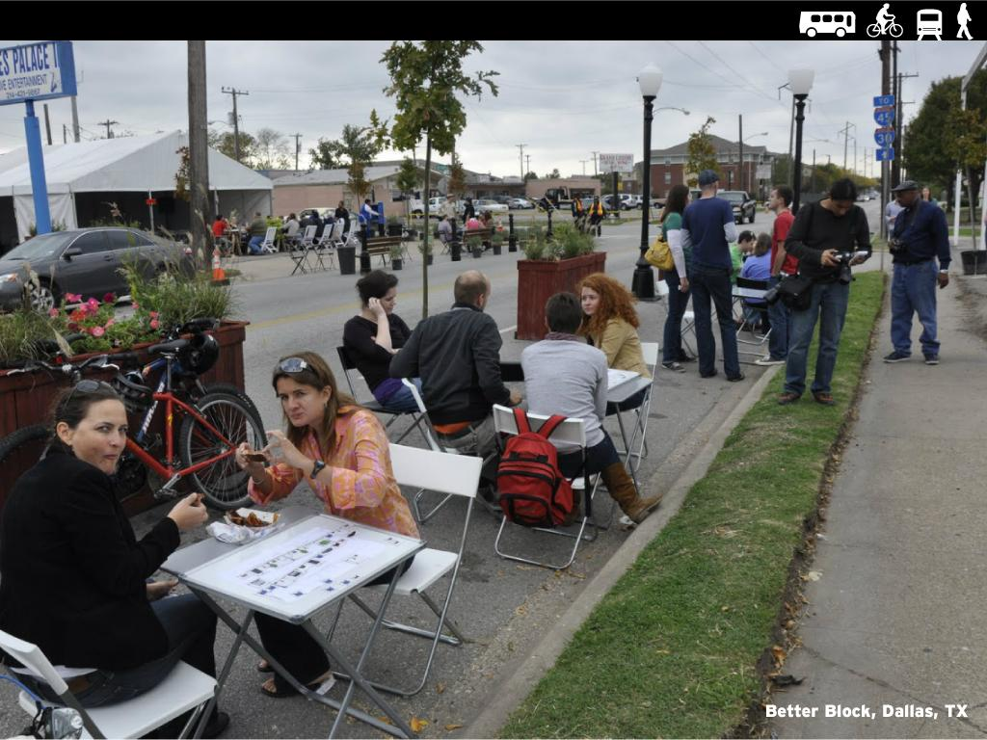
Leverage local movements across the country.
Notes:
We need to educate and empower local advocates with these messages and supporting information.
Build on the amazing grassroots energy that exists in hundreds of local bike/ped groups across this country, including in KEY LEGISLATIVE districts. We need to partner with these groups and get their members and advocates to be making it much clearer, not just to their city council members, but to their Federal elected representatives that these issues matter and that federal support and funding is crucial.

Slide 49
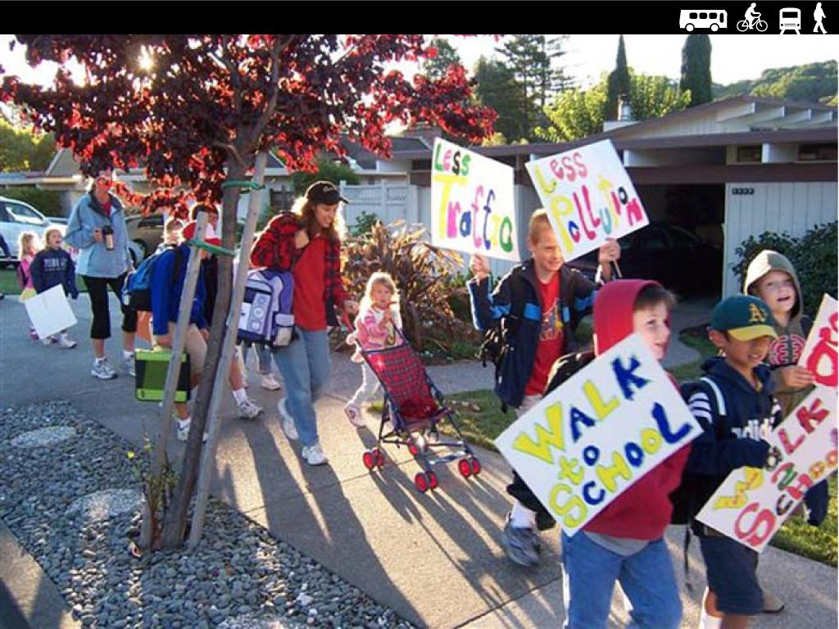
Build a coordinated network of local campaigns.
Notes:
What is needed is a national campaign that can be politically relevant on the ground in key districts and states.
We need a national campaign staff to coordinate the local advocacy. And we need to invest resources to build up local efforts in key areas (congressional districts of key people, etc.) where we are not naturally strong.
This means taking the time and energy to organize locally in many places around the country.
We need to harness the energy of existing Livable Streets advocates around the country in a coordinated approach with the goal of putting meaningful political pressure (moving votes locally) on key representatives.
This means groups of school kids marching on TV for safer routes to schools.

Slide 50
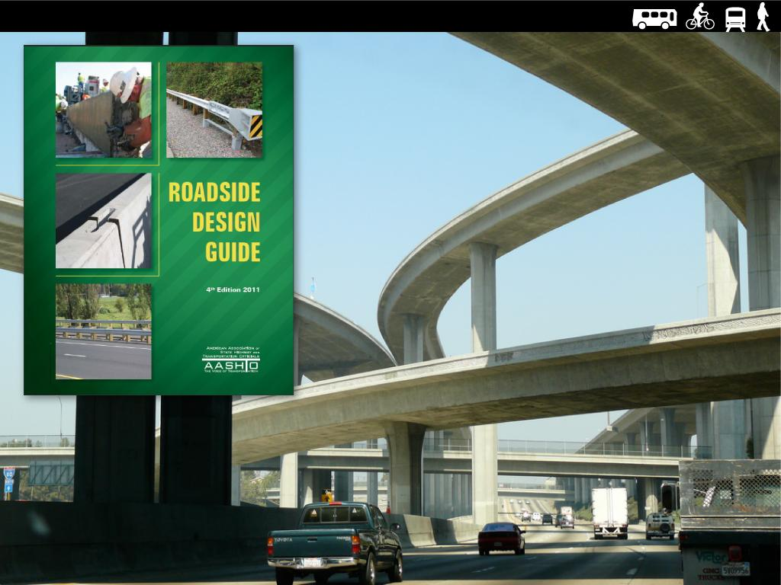
Break the Back of the Beast.
Notes:
We need to confront and engage AASHTO and state DOT's. We need to call out backward State DOT's for being hostile to human beings and willfully blind to the harm that they do to children and irresponsible money wasters who are bankrupting our country.
Nothing is going to change until some people lose their jobs, and other people fear for their jobs.

Slide 51
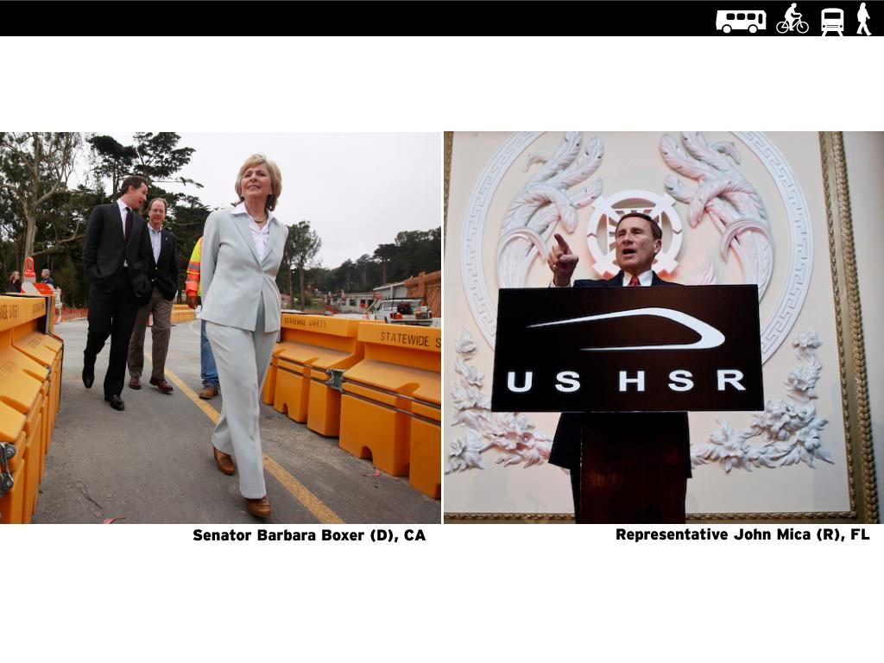
Recruit Champions.
Notes:
Find those moderate Republicans and more Democrats to champion our issues. Take the time to educate them, learn what’s important to them and frame our issues in a way that resonates.

Slide 52
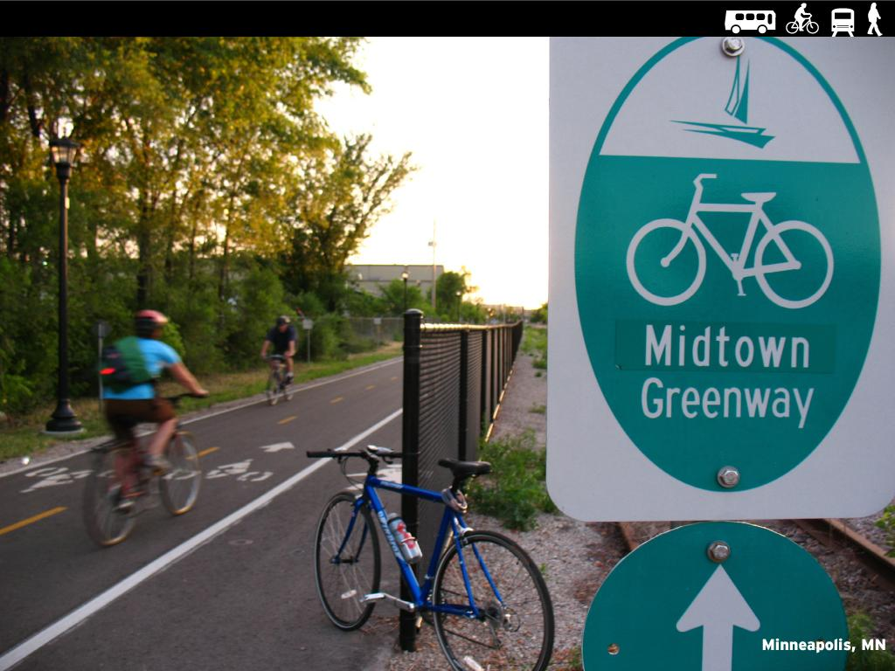
Let our successes grow.
Notes:
Show examples of success and create hunger for more and some friendly competition. Today, they exist across the country.

Slide 53
So what does this mean at a policy level?

Slide 54
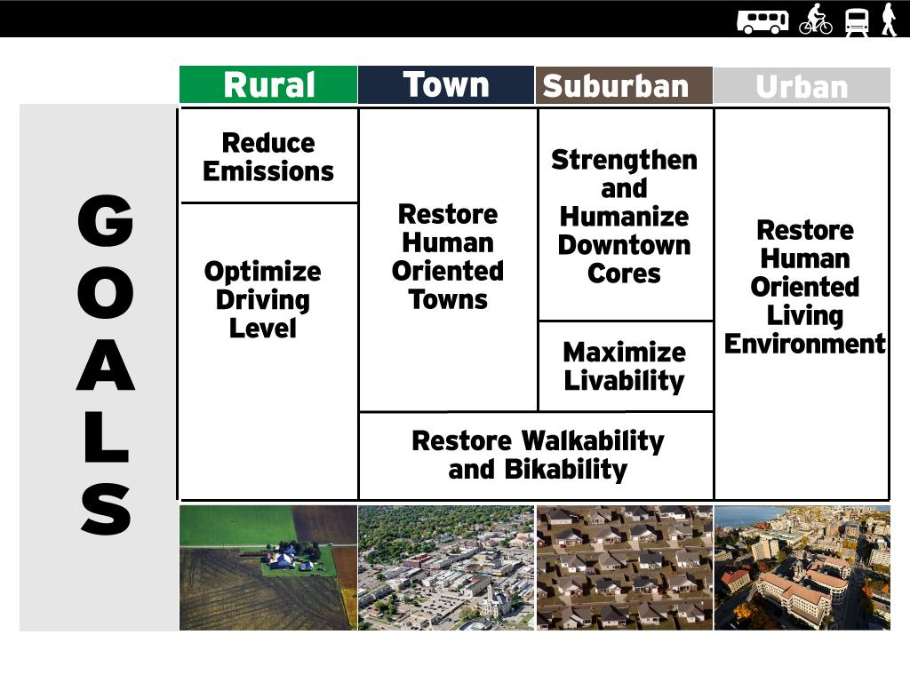
Policy Goals by Density.

Slide 55
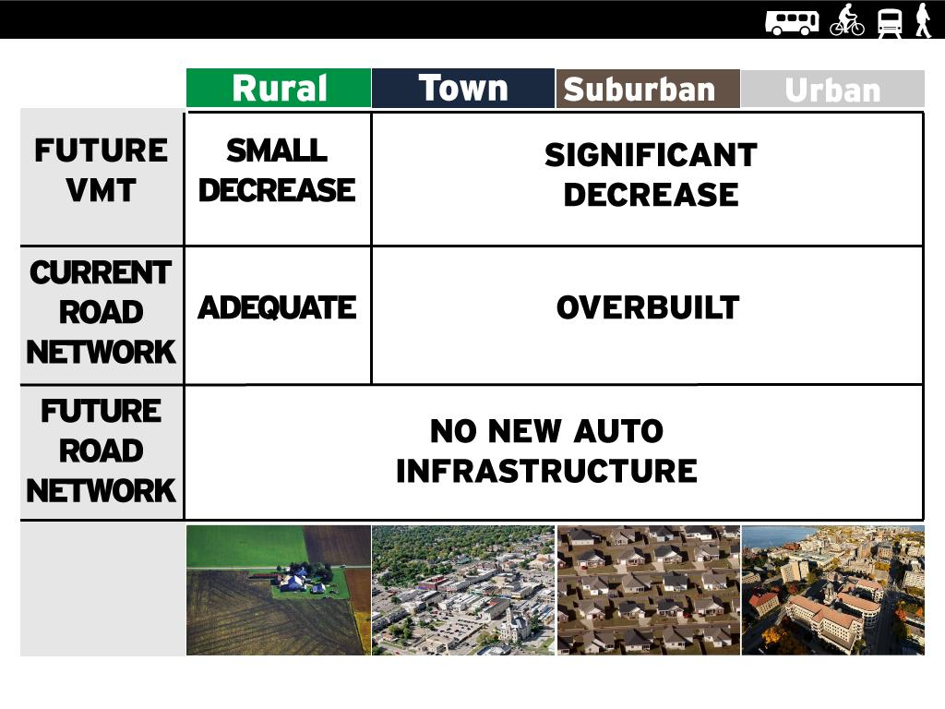
Auto Infrastructure Needs By Density.

Slide 56
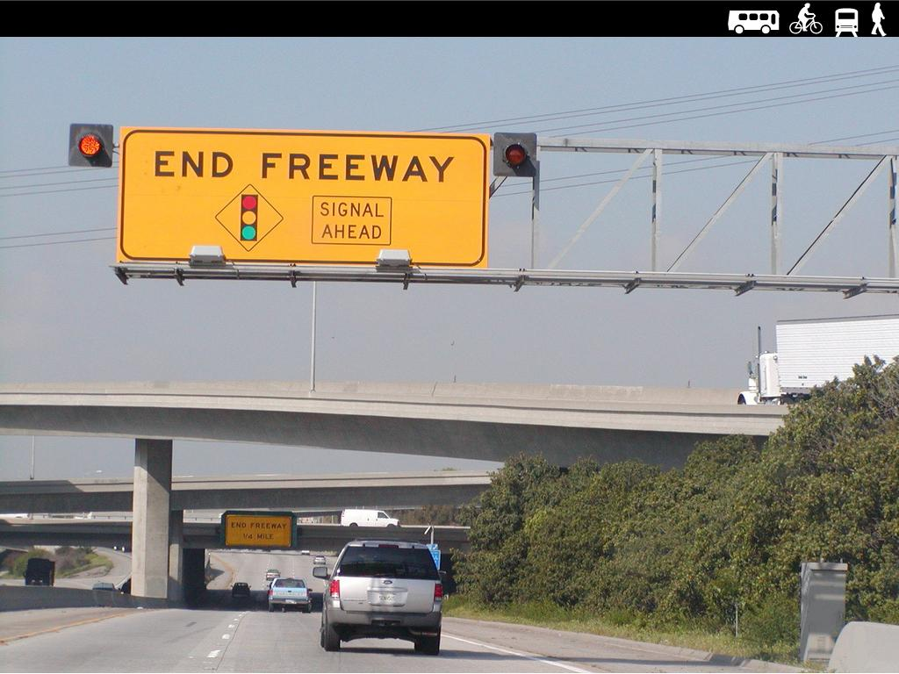
Stop building new roads and stop expanding roads.
Notes:
This means NO new roads. If a road has not managed to get built with 100 years of road building mania, then we clearly do not need it. We cannot build our way out of congestion. It is time to move on. We need to speak the truth clearly and strongly on this issue.
Only half of our major highways are in good condition. The problem is worse in urban areas where one in four roads is in poor condition. The poor condition of our nation’s highway network costs drivers on average $335 a year – or more than $2,000 over the span of a typical federal transportation authorization.
(Transportation for America - Testimony to U.S. House of Representatives) http://reconnectingamerica.org/assets/Uploads/WrittenTestimony-JohnRobertSmith-3-30-11.pdf
We have over built our road network. Our country already has too much driving. We need to stop promoting driving.
Stop building new roads and stop expanding roads.
Only half of our major highways, and one in four of our urban roads are in good condition. We should take care of what we already have, not build more stuff we can't take care of.

Slide 57
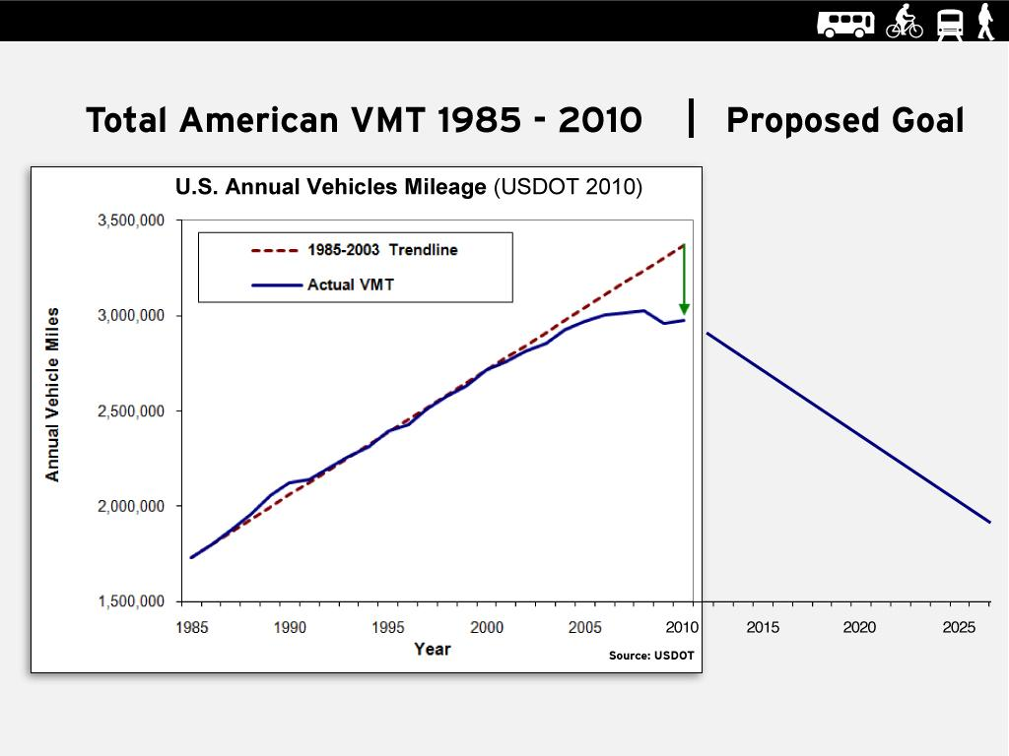
Manage for a reduction in Vehicle Miles Traveled.
Notes:
States and MPOs should set performance goals and tie funding to desired bigger picture outcomes, like reducing driving, but still get people & goods where they need to go.

Slide 58
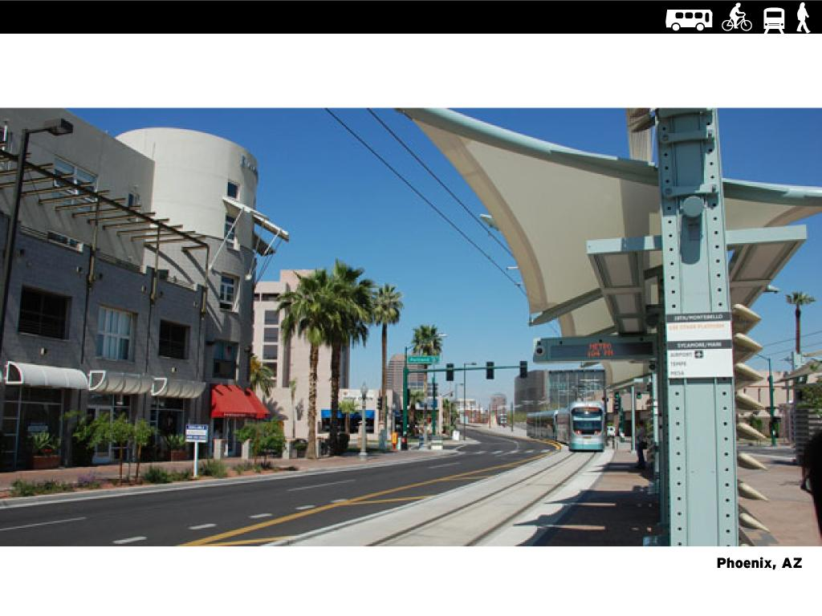
Get State DOT's out of planning.
Notes:
We need to take defacto town and city planning out of the hands of DOT's. We need to build an infrastructure and capability for meaningful town and city planning in this country. This planning capability currently does not exist. This is like a body missing an organ. DOT's should be relegated to a basic civil engineering function, not a planning function.
Totally remake the current funding infrastructure that does everything with an auto oriented mindset.

Slide 59
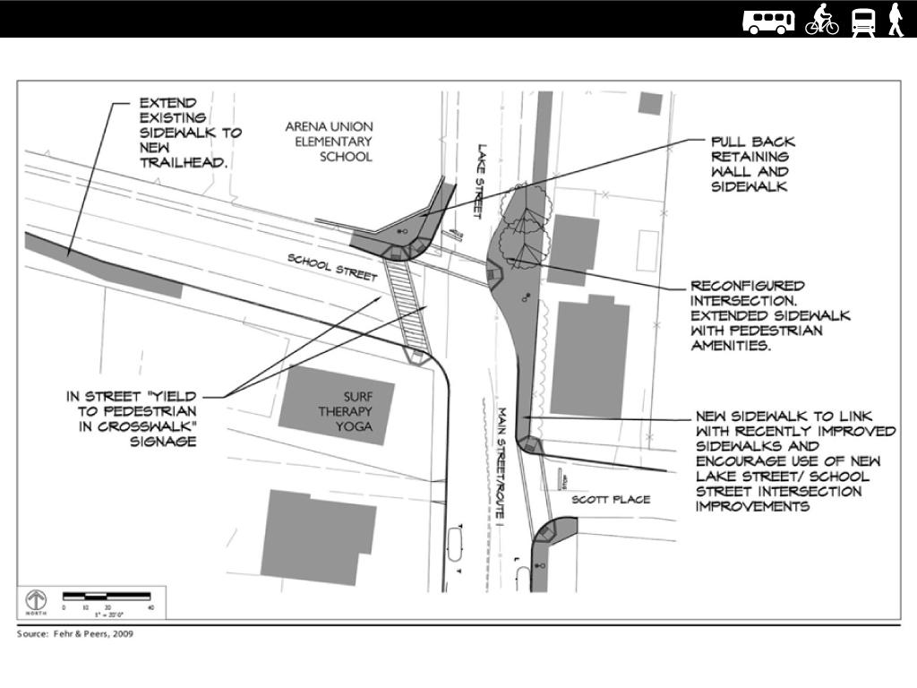
Restore balance: Invest where we have under invested.

Slide 60

Invest in walking.
Notes:
What would we get if we spent $100 billion on walking infrastructure, that is what we need to make up for the century of under investment in walking. Make the rational case for spending $100 B on walking.
http://www.nytimes.com/2012/05/27/opinion/sunday/now-coveted-a-walkable-convenient-place.html
http://www.theatlanticcities.com/jobs-and-economy/2012/09/next-major-real-estate-cycle-walkable-urbanism/3161/

Slide 61

Invest in biking.
Notes:
What would we get with $100 billion in biking infrastructure?

Slide 62

Reform the traffic engineering profession.
Notes:
Traditional traffic engineering is practiced as if there are no negative side effects of traffic. This is like a kidney surgeon who removes kidneys willy-nilly without thinking about the side effects. The lack of understanding or caring of how automobiles interact with people has done tremendous harm to our world. The accepted way of practicing traffic engineering needs to be thrown out, and we need to rebuild from the bottom up.

Slide 63

Build cost effective transit.

Slide 64

Promote dense walkable downtowns.
Notes:
We want nice dense real town cores. Even in rural areas.

Slide 65

Explain the real benefits of these policy changes.
Notes:
When you make these investments, people use them and you get less traffic congestion, more real estate value, and happier and healthier people.

Slide 66
So what will we get?

Slide 67

Kids will get back their freedom.

Slide 68

Parents will get back their freedom.

Slide 69

America's health and fitness will improve.

Slide 70

Strong Towns - Rebuilding Community.

Slide 71

Improved Economic Competitiveness.

Slide 72

Real estate values will increase.

Slide 73

Smart investments.
Notes:
Save the finances of our towns, cities, counties, states, and country
Background on Elizabeth Avenue Charlotte NC streetcar: http://theoverheadwire.blogspot.com/2009/02/elizabeth-avenue.html

Slide 74

Lower Taxes.

Slide 75

We will all have a better world to live in.

Slide 76

www.rethinktheauto.org

